Slide 1

Build the Enlightened Enterprise
An Overview of the Mortgage Demo
Powered by JBoss Enterprise Middleware –
Red Hat JBoss BPM Suite v6

Slide 2
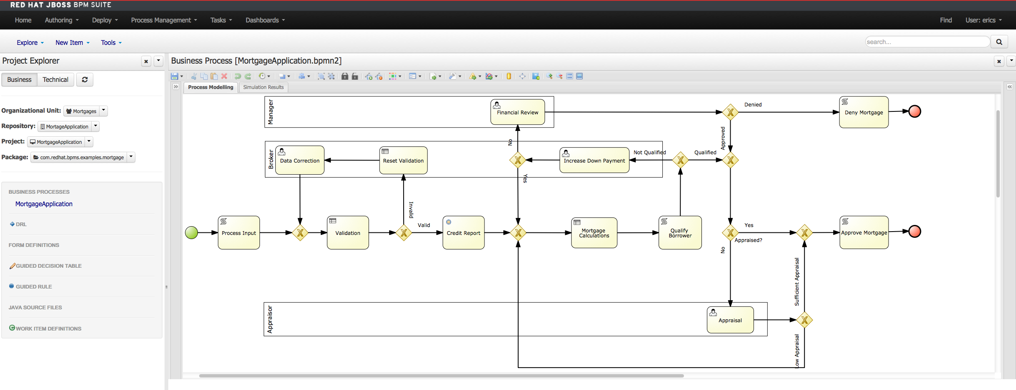
JBoss BPM Suite Mortgage Demo

Slide 3
Build the Enlightened Enterprise
For more information, please visit
http://www.jboss.com
Demo project available at:
http://github.com/eschabell/bpms-mortgage-demo
TITLE SLIDE: HEADLINE
Presenter name
Title, Red Hat
Date

